Slide 1






Employee Attrition Prediction
CCDS 223 -Data Mining Project
Group 2
Instructor: Abdullah Alghoson
Abdulalah Nasser
Abdullah Alzahrani
Mohannad Alamri
Tariq Alqhtani

Slide 2






Problem Statement and Objectives
The Problem
Our Hypotheses
Increased Costs
H1: Job satisfaction has a negative correlation with employee attrition.
High employee turnover leads to significant expenses related to recruitment, onboarding, and training
Decreased Productivity
H2: Employees with lower monthly income are more likely to leave.
Loss of institutional knowledge and disruption to team dynamics affects overall productivity
Business Impact
H3: Longer distance from home increases the likelihood of attrition.
Reduced organizational performance and potential damage to company reputation
IBM HR Analytics Employee Attrition Dataset (Kaggle)
Group 2 | CCDS 223 – Data Mining Project

Slide 3

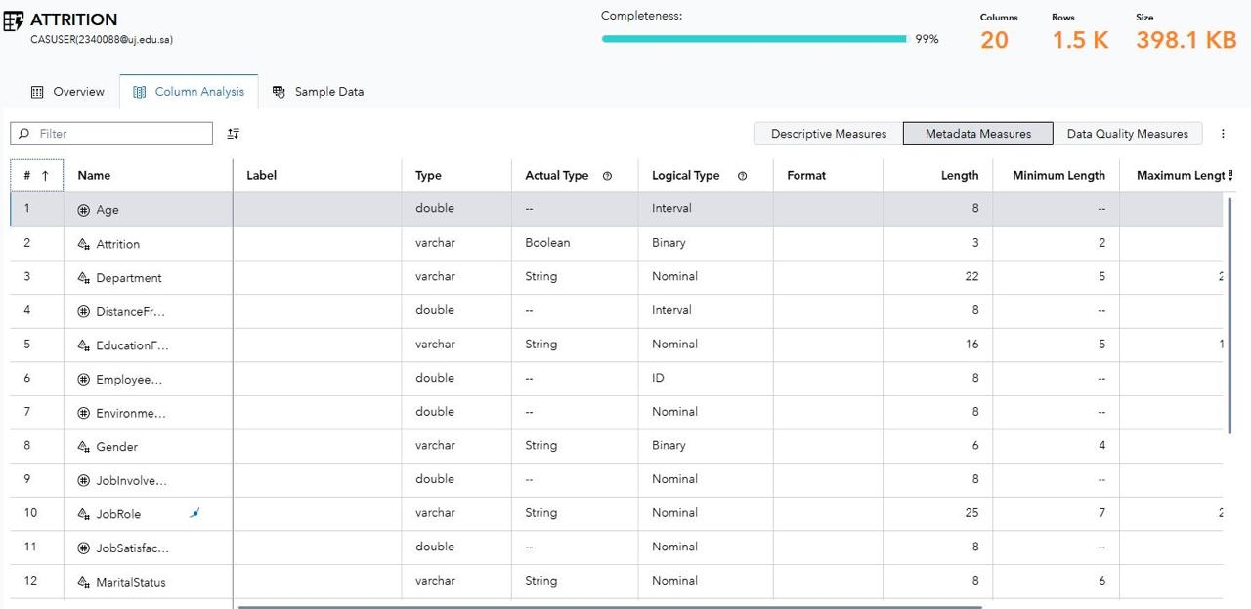



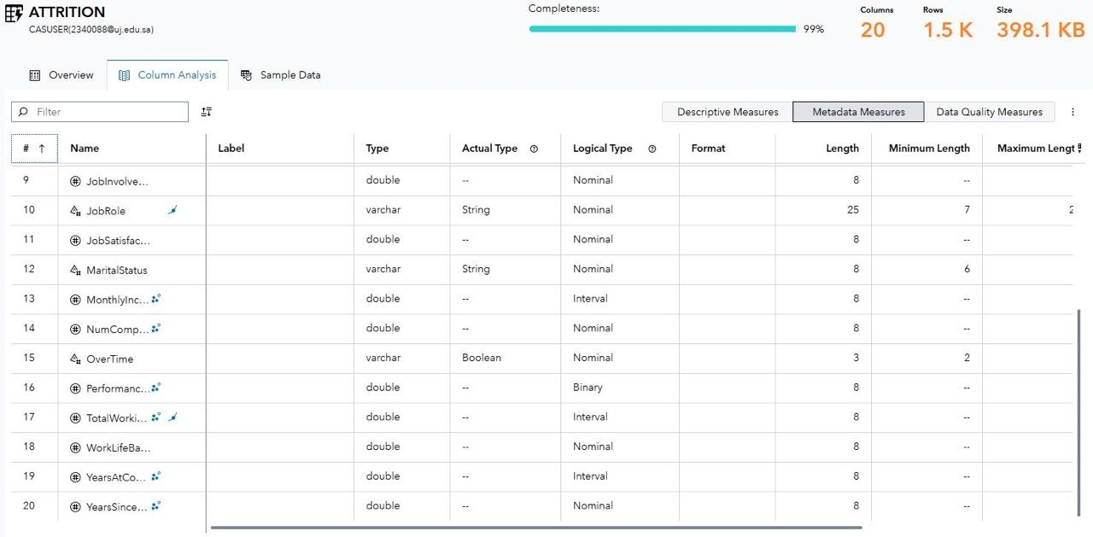

Dataset Overview
Our Dataset :
IBM HR Analytics Employee Attrition Dataset
This comprehensive dataset provides detailed information about employee characteristics and their likelihood to leave the organization. It serves as the foundation for our predictive modeling approach.
Contains information on 1470 employees
Includes 35 variables capturing various aspects of employee data
Provides a realistic foundation for analyzing attrition patterns
Data Source
IBM HR Analytics
Employee Attrition Dataset
Group 2 | CCDS 223 – Data Mining Project

Slide 4














Data Preprocessing and Feature Selection
Dataset Reduction
Selection Criteria
35
Initial Variables
Constant Variables
From original dataset
Removed features with single value
20
Final Features
Redundant Salary Features
Highly relevant attributes
Eliminated duplicate salary info
Low-Value Features
Removed attributes with minimal predictive power
Removed Features
DailyRate
EmployeeCount
JobLevel
Feature selection improved model efficiency and accuracy
Outliers assessed and scaling techniques applied
Group 2 | CCDS 223 – Data Mining Project

Slide 5


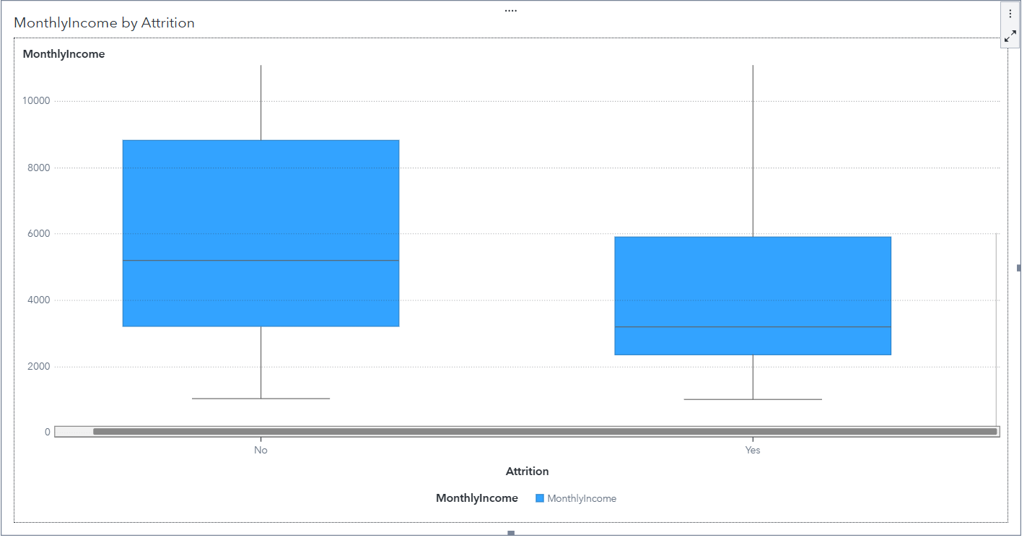
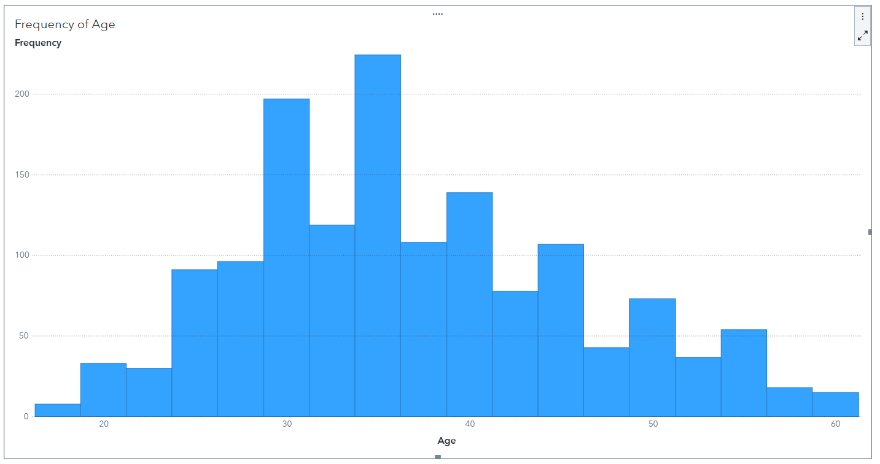

Exploratory Data Analysis
Box plot :
Histogram:
Measure: Monthly Income
Category: Attrition
Insight: The employees that have lower salaries are more likely to leave the company.
Measure: Age
Employees at the very early career stage <22 and nearing retirement >55 appear only in small numbers
Financial factors are a significant driver of employee attrition
Group 2 | CCDS 223 – Data Mining Project | Slide 5

Slide 6



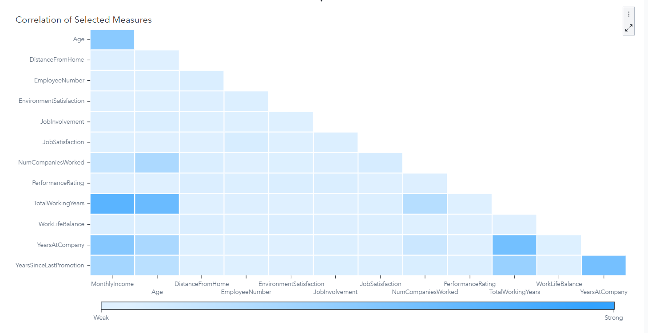
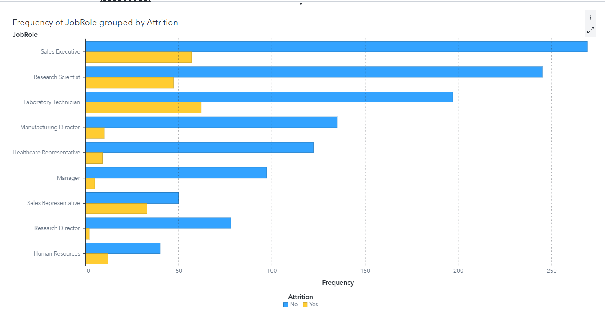

EDA - Job Roles and Correlations
Job Roles Analysis
Correlation Findings
Sales Representatives and Laboratory Technicians show disproportionately high attrition rates relative to their workforce size.
Exploratory Data Analysis
Page 6 | Group 2 | CCDS 223 – Data Mining Project

Slide 7

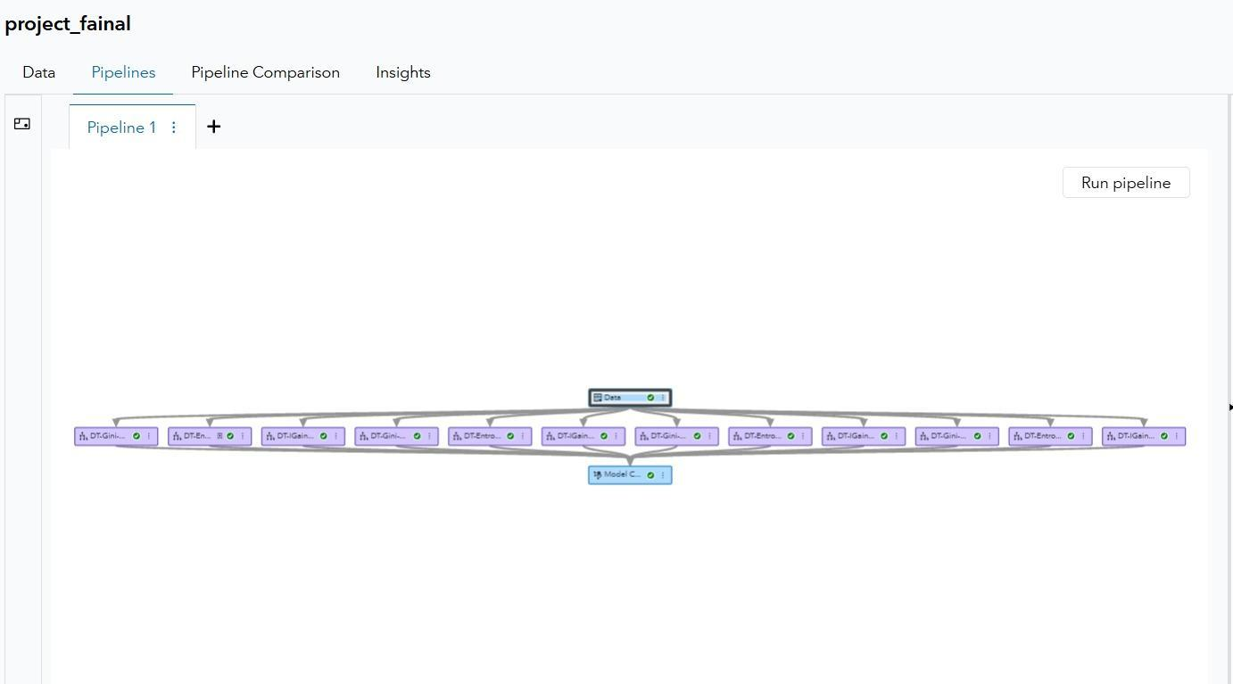

















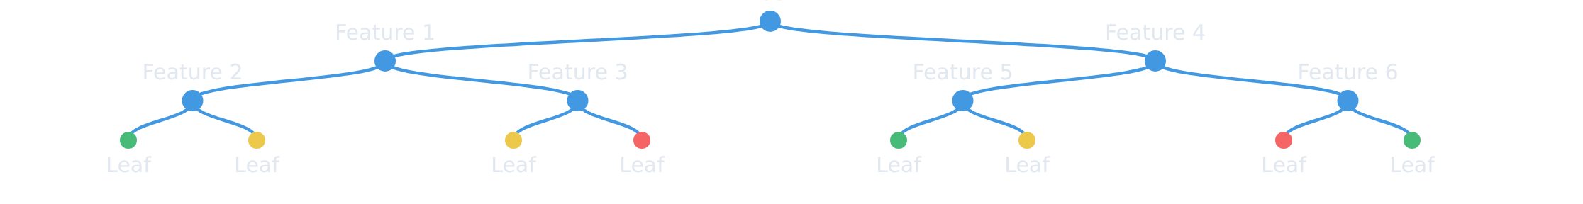
Decision Tree Modeling Strategy
Decision Tree Models
Strategy Overview
Model Selection
Information Gain
Entropy
Criterion
Gini
Criterion
Model Comparison
Criterion
Decision Trees were chosen for their excellent interpretability and clear structure, making them ideal for HR applications
Leaf Size 10
Leaf Size 10
Leaf Size 10
Leaf Size 20
Leaf Size 20
Accuracy
Leaf Size 20
Leaf Size 30
Leaf Size 30
Simplicity
Leaf Size 30
Leaf Size 40
Leaf Size 40
Interpretability
Comprehensive Testing
Leaf Size 40
Information Gain
Built 12 different models by testing 4 different leaf sizes against 3 building criteria
Decision Tree Structure Example
Information Gain Entropy Gini
Key Benefit
Interpretable models allow HR teams to understand and implement recommendations easily
12 models tested for optimal interpretability and accuracy
Group 2 | CCDS 223 – Data Mining Project

Slide 8
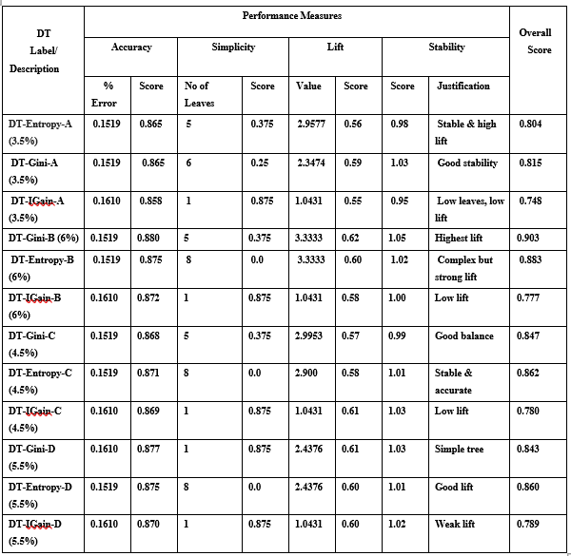
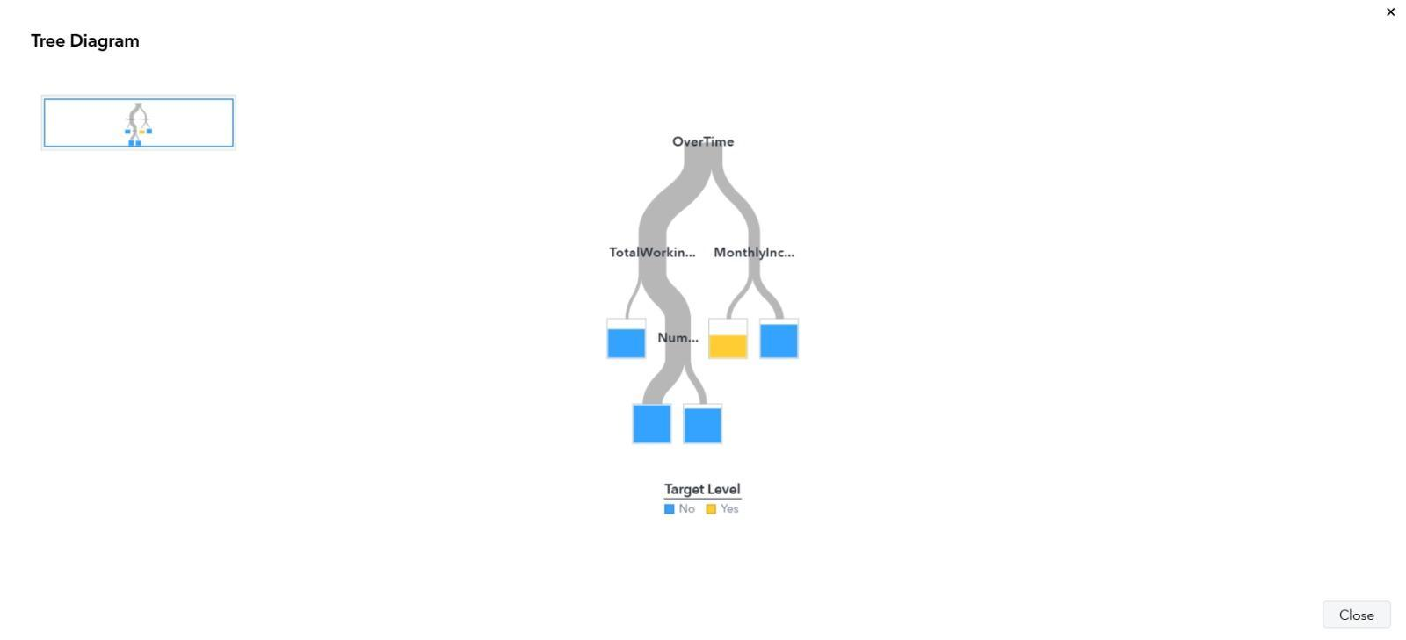
Decision Tree Modeling Strategy
Summary of Results :
Tree Node :
Model Selection
Entropy
Criterion
Gini
Criterion
Model Comparison
Decision Trees were chosen for their excellent interpretability and clear structure, making them ideal for HR applications
Leaf Size 10
Leaf Size 10
Leaf Size 20
Leaf Size 20
Accuracy
Leaf Size 30
Leaf Size 30
Simplicity
Leaf Size 40
Leaf Size 40
Interpretability
Comprehensive Testing
Information Gain
Built 12 different models by testing 4 different leaf sizes against 3 building criteria
Key Benefit
Interpretable models allow HR teams to understand and implement recommendations easily
To better understand the behavior of the selected best model (DT-Gini-B, 6%), the final Decision Tree structure was visualized
12 models tested for optimal interpretability and accuracy
Group 2 | CCDS 223 – Data Mining Project

Slide 9



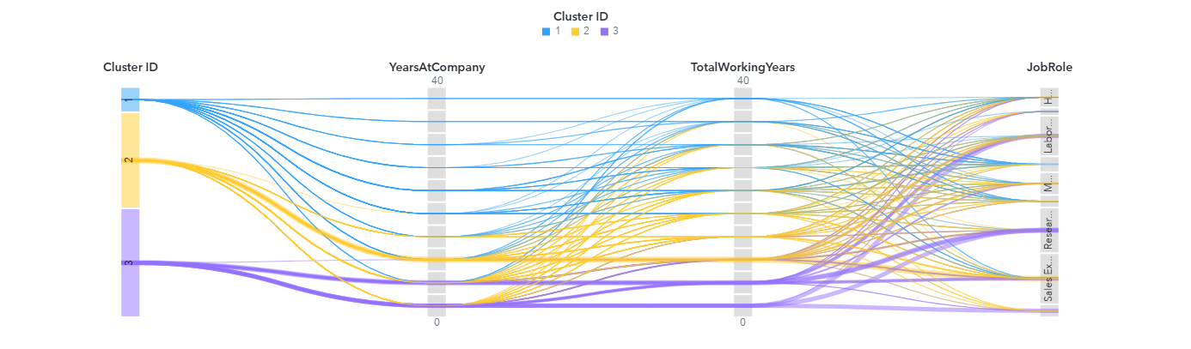
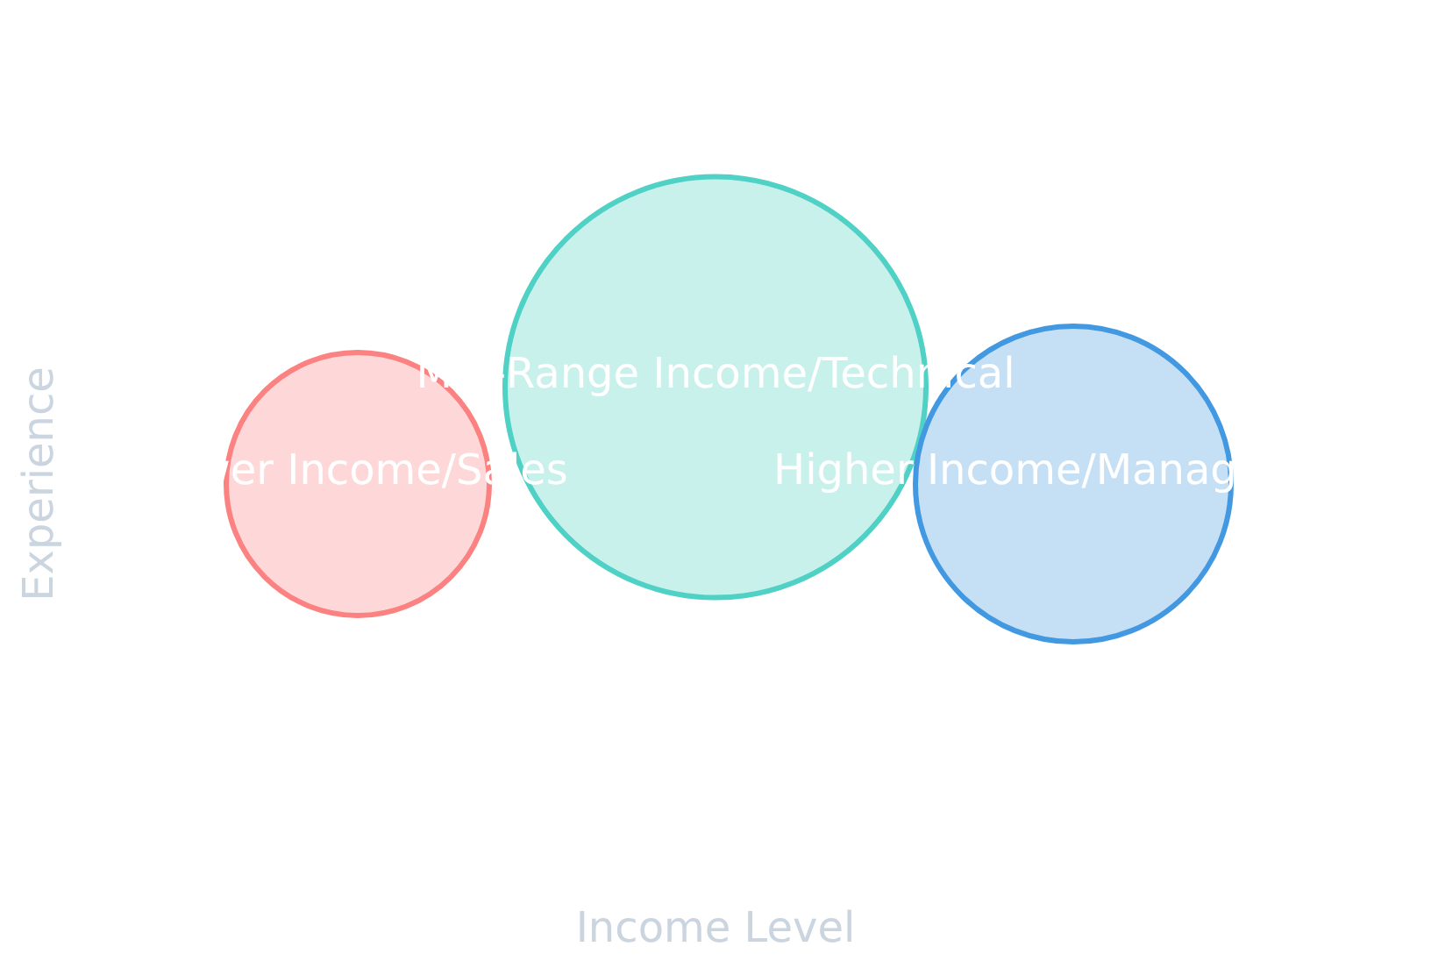






K-Means Clustering Analysis
We performed K-Means clustering to segment employees into distinct groups for more targeted HR interventions.
Cluster Visualization
Employees with lower monthly income
Primarily in sales roles
Often entry-level positions
Cluster 2: Mid-Range Income/Technical
Largest cluster of employees
Mid-range income levels
Technical roles predominance
Cluster 3: Higher Income/Management
Higher monthly income employees
Management and senior roles
Cluster 1
Cluster 2
Cluster 3
Most experienced group
8/12

Slide 10













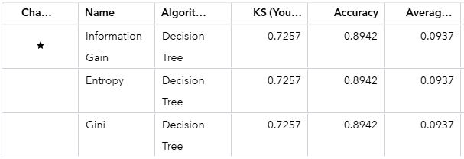
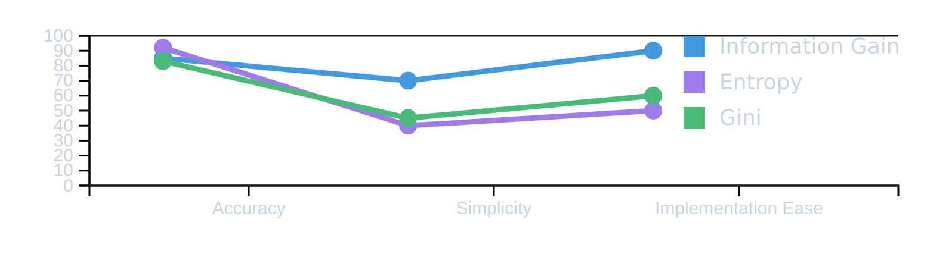
Model Performance and Selection
Model Selection Criteria
Performance Comparison
Information Gain
Criterion
Accuracy
Model Simplicity
Implementation Ease
Balanced accuracy and simplicity across models
Entropy
Information Gain
Favored accuracy with increased complexity
Gini
Entropy
Similar to Entropy with slight performance differences
Gini
Why Information Gain?
High predictive accuracy for HR decisions
Model simplicity enables easier interpretation
Practical for implementation in HR teams
Information Gain criterion provides the best balance for implementation
Group 2 | CCDS 223 – Data Mining Project

Slide 11












Key Findings and Insights
Primary Attrition Drivers
Clustering Value
Low Monthly Income
Targeted Retention Framework
Employees with lower monthly income are significantly more likely to leave the organization
Segmenting employees provides a framework for targeted retention strategies tailored to specific employee groups
Specific Job Roles
Roles like Sales Representative and Laboratory Technician show higher attrition rates relative to their size
Cluster-Specific Insights
Cluster 1: Lower income/Sales
Cluster 2: Mid-range income/Technical
Cluster 3: Higher income/Management
Lack of Recent Promotion
Employees without recent promotion are at significantly higher risk of leaving the organization
Decision Tree model identified these key factors
Group 2 | CCDS 223 – Data Mining Project

Slide 12










Recommendations and Implementation
Primary Recommendation
Implementation Strategy
HR should prioritize a review of compensation and benefits for roles identified with low income and high attrition, particularly:
Segment employees using our clustering model to identify high-risk groups
Develop targeted compensation adjustments for low-income roles
Sales Representatives
Create clear career advancement paths for technical roles
Laboratory Technicians
Implement data-driven retention policies that address financial factors, which we've identified as a major driver of attrition.
Expected Outcomes
Reduced employee turnover
Improved organizational performance
Enhanced company reputation as an employer
Data-driven retention strategies lead to sustainable business growth
Group 2 | CCDS 223 – Data Mining Project

Slide 13










Questions and Discussion
Thank You
for your attention and participation
We are now open for questions
Feel free to ask about our employee attrition prediction model, methodology, or findings
Employee Attrition Prediction Project
Group 2 | CCDS 223 – Data Mining Project

